Slide 1
Risk Response Planning
Module 5

Slide 2
Objectives
Risk response strategies- how to respond to negative and positive risks
Risk control to limit exposure to risk
How to mitigate negative and opportunity risk
Monitoring risk throughout risk management life cycle
Apply the COSO framework to risk mitigation and monitoring
Notes:
This module is targeted at risk assessment in the risk management process
principles of COSO framework:
The five components of COSO – control environment, risk assessment, information and communication, monitoring activities, and existing control activities

Slide 3
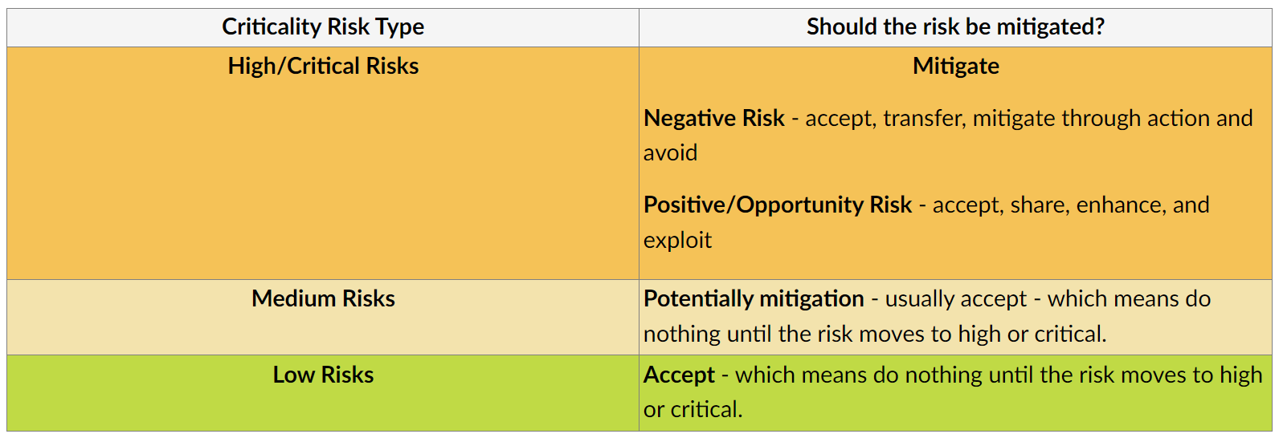
Risk Response Planning
To take a proactive posture
To understand what resources will be needed for risk management.

Slide 4

Positive Risk Response Strategies
Escalate: transfer
Enhance: try to seize the opportunity
Exploit: optimum strategy
Accept: least desired strategy
Share: when solo realization of opportunity is hard
Notes:
Taken from Risk Response Strategies for Positive Risks or Opportunities
Escalate:entrust top management to handle the risk, and your job is limited to monitoring by recording it in your risk register; can be used with positive and negative risks.
Enhance: increase the chance of a risk happening so you can realize it. In this case, you try to seize the opportunity. The enhance risk response is the opposite of the mitigate strategy. to increase the probability (reduce the uncertainty or the impact or both) associated with a positive risk.
Exploit: ensure that the opportunity is realized. You do not try; you make certain to seize it.
Accept: take no action to realize the opportunity. You use this strategy when the response cost is high, there is a low chance of it occurring, or the benefit does not outweigh the effort. can be used with positive and negative risks.
Share: when you cannot realize the opportunity alone. So, you team up with another company and work together. E.g. the organization may share cost, resources, knowledge, etc... in order to avail the opportunity. If the opportunity is realized, the benefits (Impact of the Positive Risk Event) are also shared. Apple worked with Samsung for chips for the Apple iPhone. Some other examples are forming technology partnerships, establishing new companies jointly or launching new products jointly.
+ve risk = opportunity
If the risk is negative, you will try to avoid or minimize the impact. If the risk is positive, you will want to realize its benefits. As these are distinct types of risks, the strategies to deal with them are different.
The optimum strategy for an opportunity is “exploit,” However, it is not possible to use this strategy all the time.
Accept is the least desired strategy; if you take no action and hope the risk is realized on its own.

Slide 5
Negative risk response strategies
Escalate: pass it on to the higher ups
Mitigate: actionable plan to lessen the risk and implement with control
Transfer- to insurance company or third party.
Avoid: Making necessary changes to avoid risk
Accept: determination that it is too costly to mitigate the risk
Notes:
Taken from Negative Risk Response Strategies in Project Management
Escalate: when you cannot manage risk because you lack authority, resources, or knowledge.Once the higher authority accepts, you won’t take further action other than updating the risk register.
Mitigate: helps you lessen the impact or probability of the risk. This strategy decreases the severity.
Transfer (transfer the responsibility to a third party): when you lack the skills or resources to manage the risk or are too busy to manage it.
Avoid: try to eliminate the risk or its impact. You do this by changing your project management plan, scope, or schedule. You use this strategy with critical risks.
Accept: take no action to manage the risk other than acknowledging it. You use this strategy with non-critical risks when it is not possible or practical to respond using other strategies or if it is of little importance and does not call for a response. You can accept the risk either by actively or passively acknowledging it. In an active acceptance strategy, you keep a separate contingency reserve to manage the risk, and in passive acceptance, you do nothing except record it in the risk register.
-----------------------------------------
Controls are put in place to lessen the risks. It is important to understand what processes would be affected by the risk. For example, installing disaster warning systems, purchasing radio communications equipment, or conducting emergency response training.

Slide 6
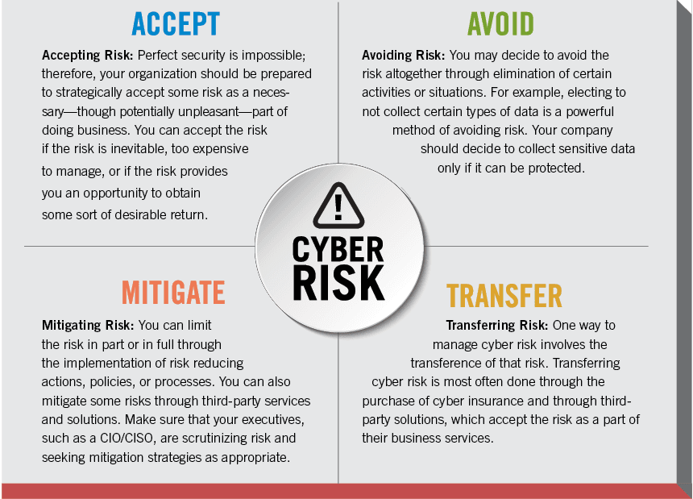
Cyber Risk Mitigation
Notes:
Taken from Manage Cyber Risk Like Yahoo? No!
“A few weeks after Yahoo revealed the 2014 hack of some 500 million accounts, they announced the 2013 hack of one billion email accounts. Yahoo’s stock dropped 6% in one day, and Verizon is threatening to cancel the pending transaction. How was the Yahoo board unaware of their cyber risk condition for years? Clearly, overseeing cyber risk wasn’t a high priority.”

Slide 7
Cyber Risk Mitigation
Risks
Data Breach
Phishing Attacks
Mitigation Strategies
Data Encryption
Data access control
Data backup practices
Employee training
Network Security plans
Incident recovery and response plan

Slide 8

Steps for making decisions about risk mitigation
Identify a risk owner
Risk register
Look at the quantitative and qualitative analysis
Identify subject matter experts to support the mitigation strategies
Work with the risk management department to test that the mitigations will work.
Notes:
The analysis is used as a resource for the risk treatment plan to rescore the risks once mitigation measures are documented and executed.
A Risk Owner must be assigned to the risk mitigation strategy. The risk owner is the person closest to the risk and able to identify when the risk has become an issue. A risk owner would be someone from a business area that is closest to the risk
E.G:
A marketing manager is familiar with the marketing program for a lending product. The marketing manager requests a data report based on prospects interested in the lending product discovered via visits to the organization’s website or calls to the customer service center or questions on the company’s blog or going to a branch office to ask questions regarding the product.
The risk owner will escalate the risk to the proper parties within the organization once the risk becomes an issue. In data management situations, risks are escalated to the head of data management or through the data governance process so that critical risks and issues are communicated to critical members of management

Slide 9

Risk Monitoring- Root cause analysis
Steps to identify the root cause as part of monitoring risk:
Define the event
Finding the root cause
Find solutions
Take action
Verify solution effectiveness
Notes:
Example: Bridge Collapse
The risk event is the bridge collapse. What drove the cause? Bad design, bad material or both. First, investigate to find the root cause. Once the root cause is determined, find the solutions to fix it. Once determined, then mitigate for the risk so there is not a similar issue with other projects. Finally, test the solution to ensure the design and materials are correct and won't fall again.
Root cause analysis helps determine the drivers of the risk and pinpoints the issues.

Slide 10
Risk Monitoring
Periodic or ongoing evaluations for the functioning of:
Controls that support the risk
The current risk management process
Reviewing the key risk indicators which drive a proactive risk management
Helps to identify when risks are becoming an issue

Slide 11

For the Data Analyst
Risk appetite: understand the position of the organization when it comes to mitigating a risk as some organizations will simply accept risk while other organizations will implement measures to lessen the risk
Risk Culture: Understanding the risk culture and the organization’s stance on risk mitigation is important when you are identifying risk within your data analysis.

Slide 12
In_Class Activity- Risk Response Planning
Using the risk heat map, quantitative and qualitative risk assessment from your prior activity as a guid, develop the risk responses
Considerations:
Brainstorm and develop risk response plans for the top-priority critical risks.
Consider applicable response strategy (risk avoidance, mitigation/reduction, transfer, acceptance ) and justify your choice for the risk(s) under consideration.
Note: critical thinking and creativity is required for this activity
Notes:
Riisk management with

